Slide 1

Probability and Statistics
Lecture 2
By/ aly maher abdelfattah

Slide 2
outlines
The Theorem of Total Probability
Baye’s Rule
Discrete Probability Distributions
Cumulative distribution function

Slide 3
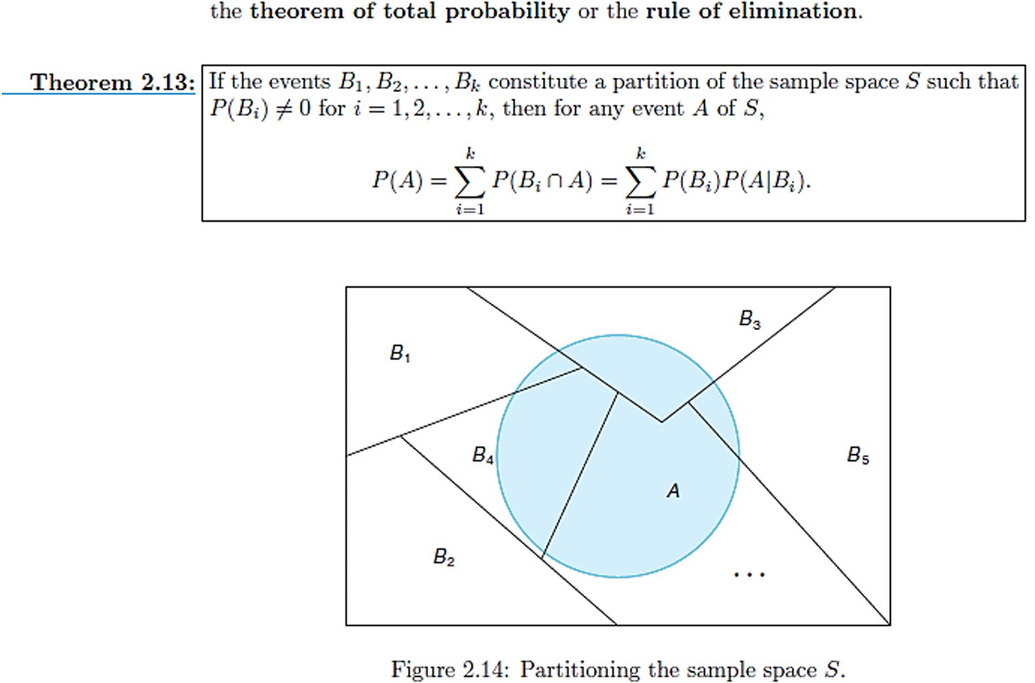
The Theorem of Total Probability

Slide 4
The Theorem of Total Probability

Slide 5
The Theorem of Total Probability

Slide 6
Baye’s rule

Slide 7
Baye’s rule

Slide 8
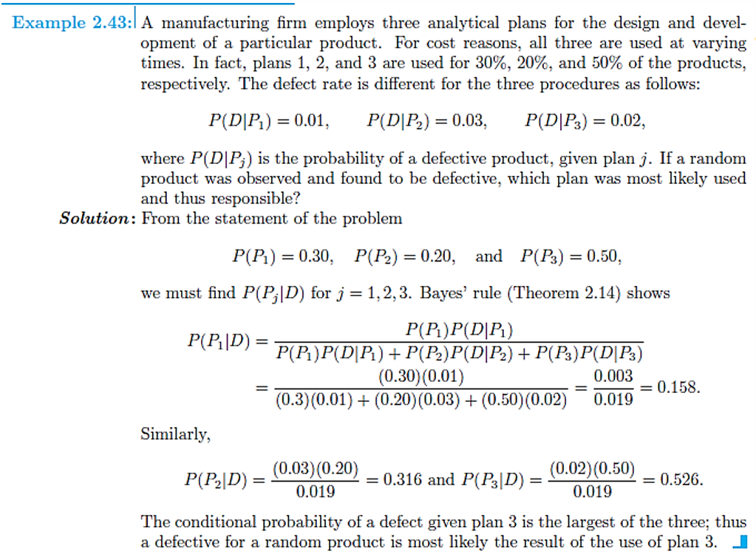
Baye’s rule

Slide 9
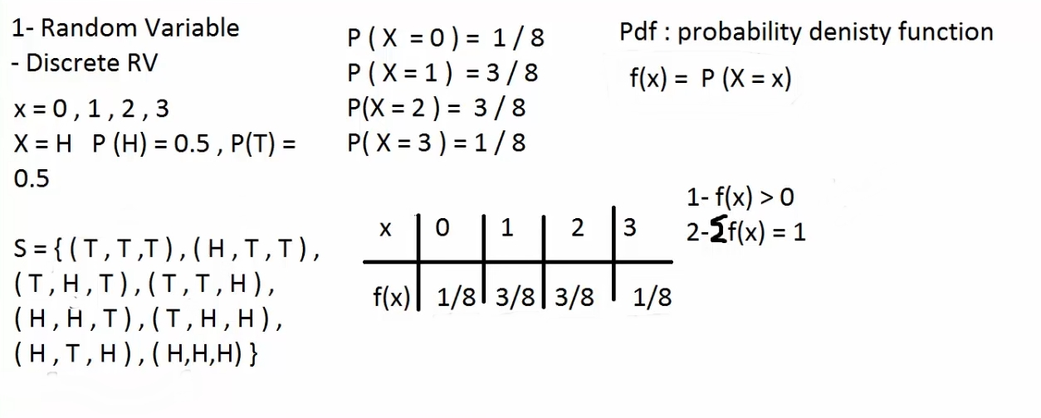
Discrete Probability Distributions

Slide 10
example

Slide 11
Cumulative distribution function

Slide 12
Cumulative distribution function

Slide 13

Thank you

